Slide 1
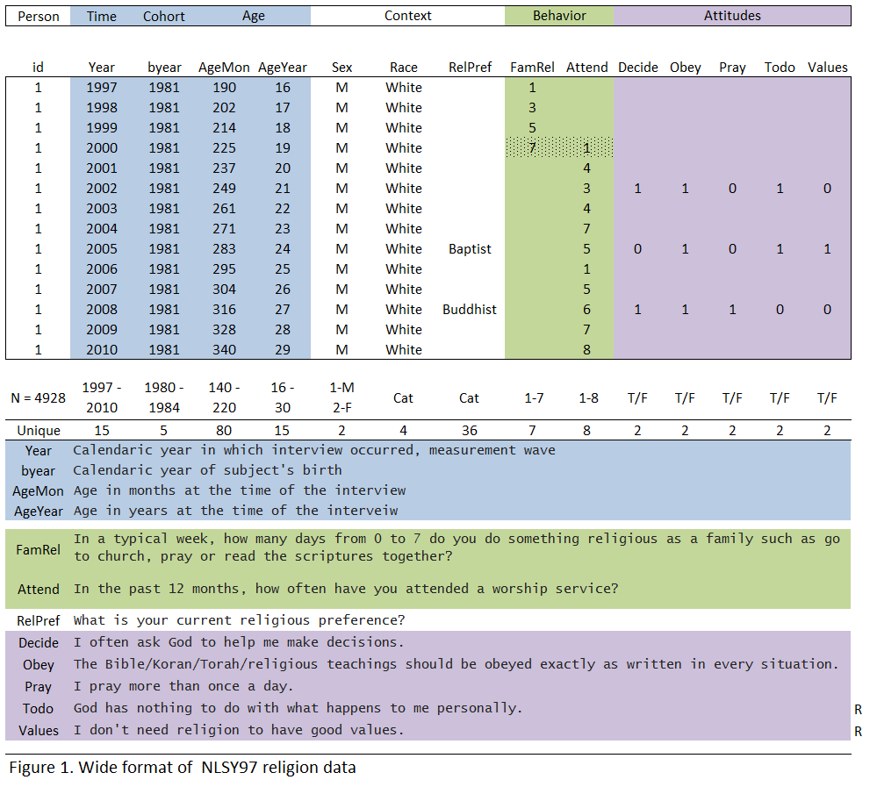

Slide 2
A Simple EMOSA Sexuality Model
Rowe, Rodgers, & Meseck-Bushey, 1989, Social Biology:
P_{t+1} = P_{t} + T (P_{t}) (1-P_{t}) + k (1- P_{t}) (1-P_{t})
Carry-Over Epidemic Non-epidemic
P_{t} is prevalence at time t
T is the epidemic transmission parameter
k is the non-epidemic transmission parameter
Notes:
Only two categories. If there are three categories – number of transmission parameters will increase to accommodate the structure

Slide 4
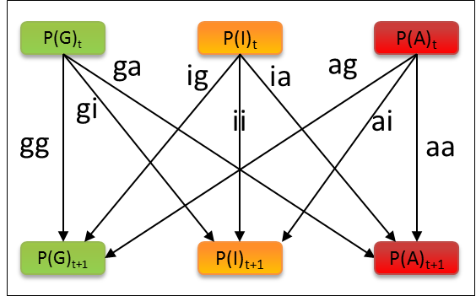
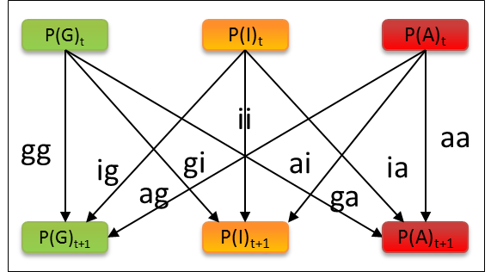
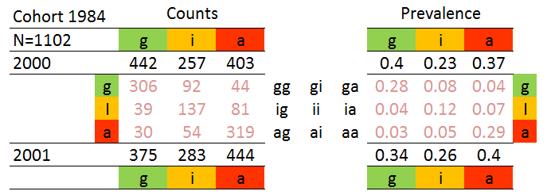
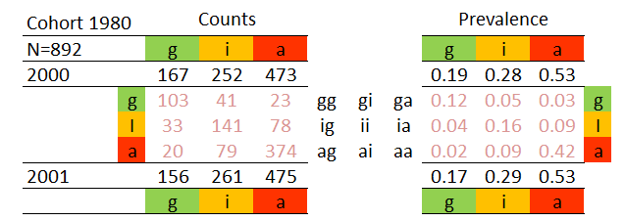
9 Transitions
6 Pairings

Slide 5
Numerical Example
.6
.3
.1
P(G)_{t}
P(I)_{t}
P(A)_{t}
P(G)_{t}
P(I)_{t}
P(A)_{t}
ii
.36
.09
.01
gg
aa
ig
gi
ai
ia
.18
.18
.03
.03
ag
ga
.06
.06
P(G)_{t+1}
P(I)_{t+1}
P(A)_{t+1}
P(G)_{t+1}
P(I)_{t+1}
P(A)_{t+1}
.36
.09
.01
.36
.06
P(G)_{t}
P(I)_{t}
P(A)_{t}
.12
ag
ga
ig
gi
ai
ia
gg
ii
aa
.46
.54
P(G)_{t+1}
P(I)_{t+1}
P(A)_{t+1}
1

Slide 6
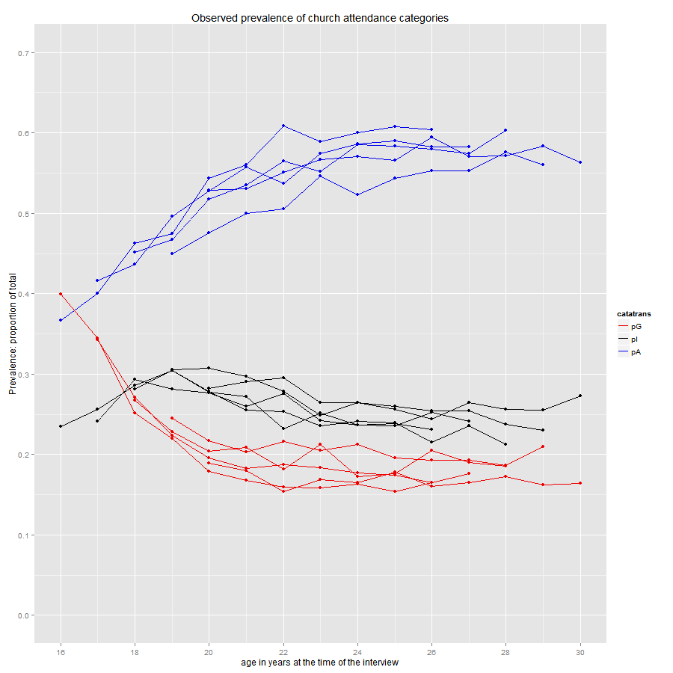
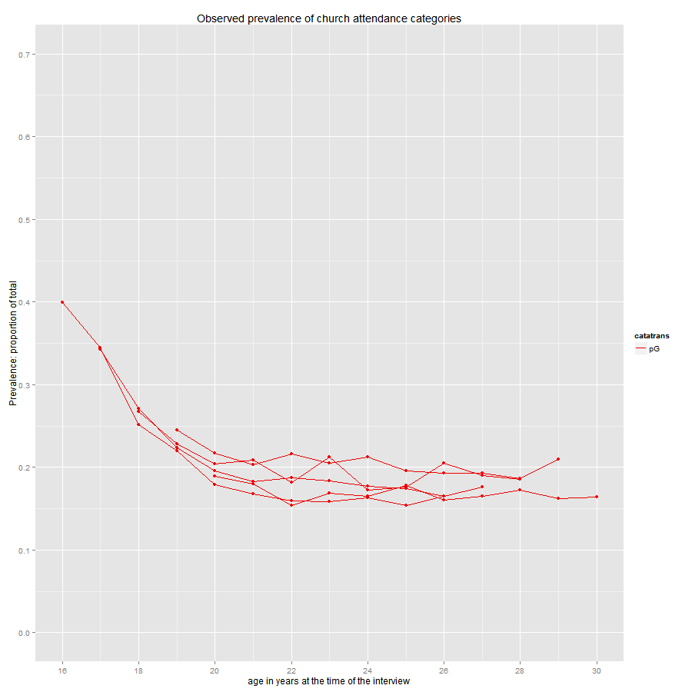
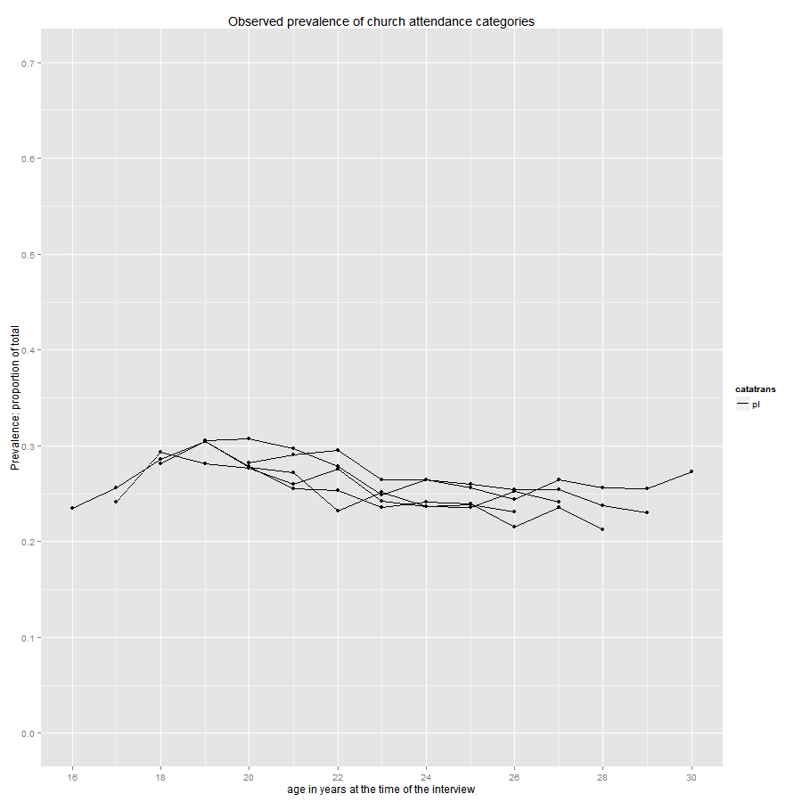
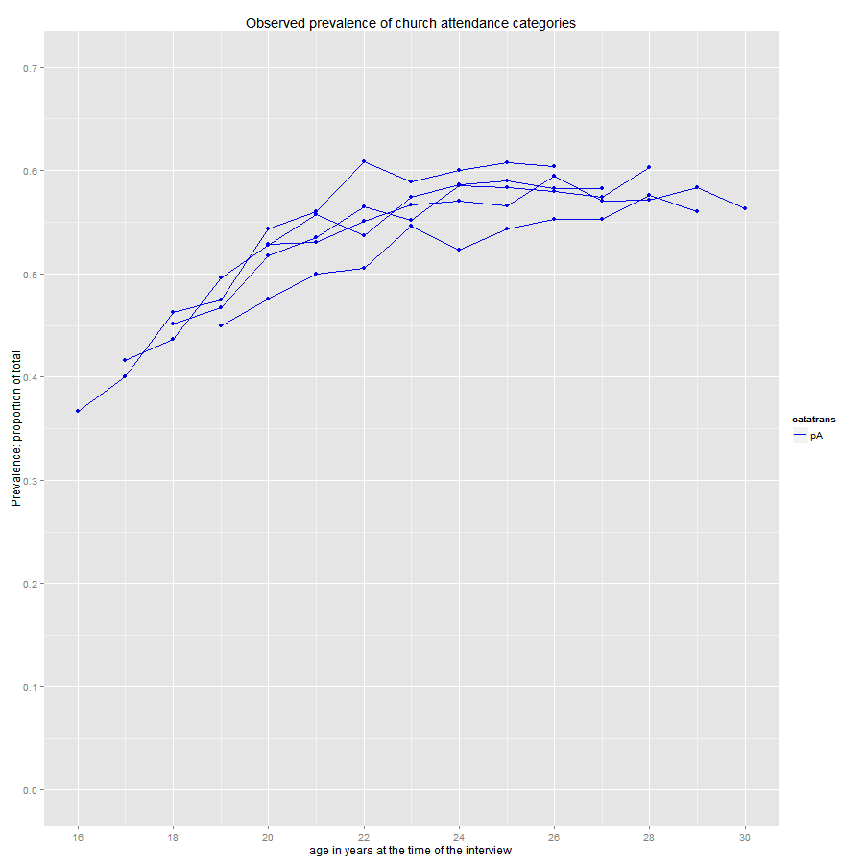
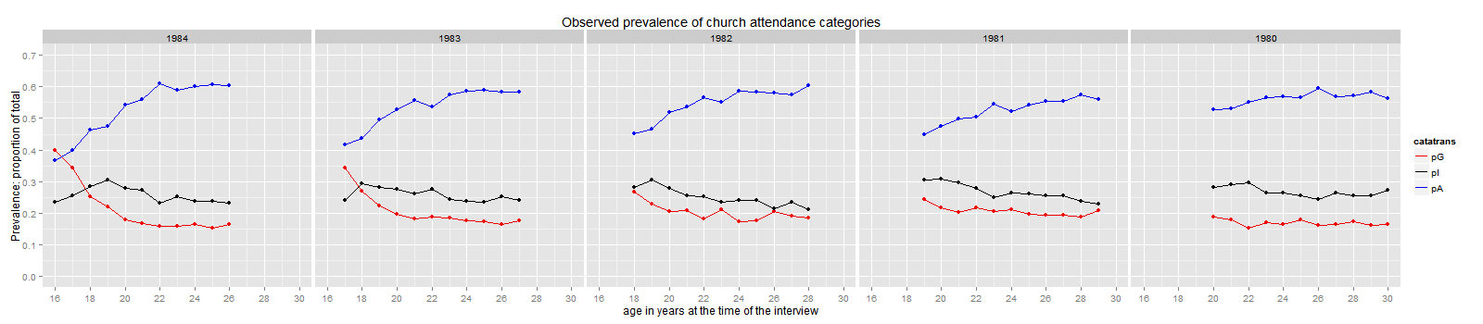
Observed prevalences attendance categories
Goers
Irregulars
Absentees

Slide 7
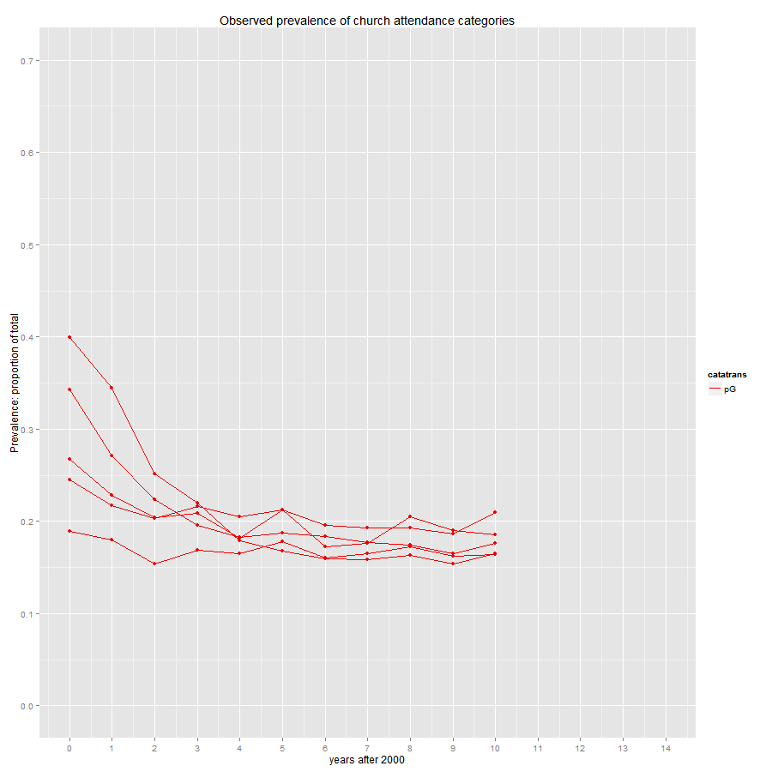
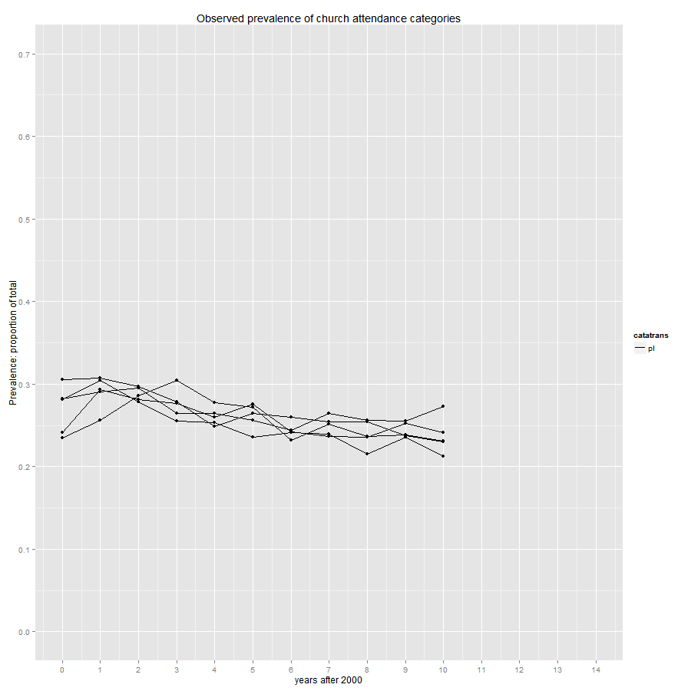
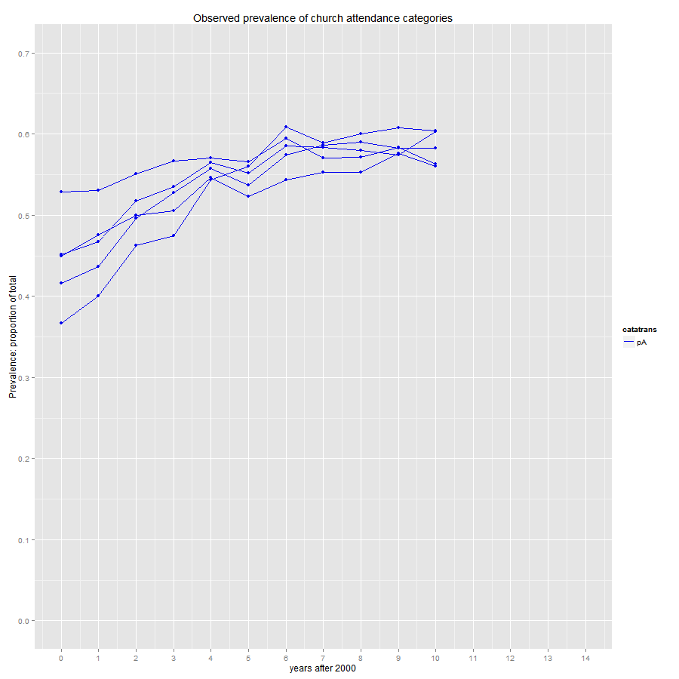
Observed prevalences attendance categories
Goers
Irregulars
Absentees

Slide 8
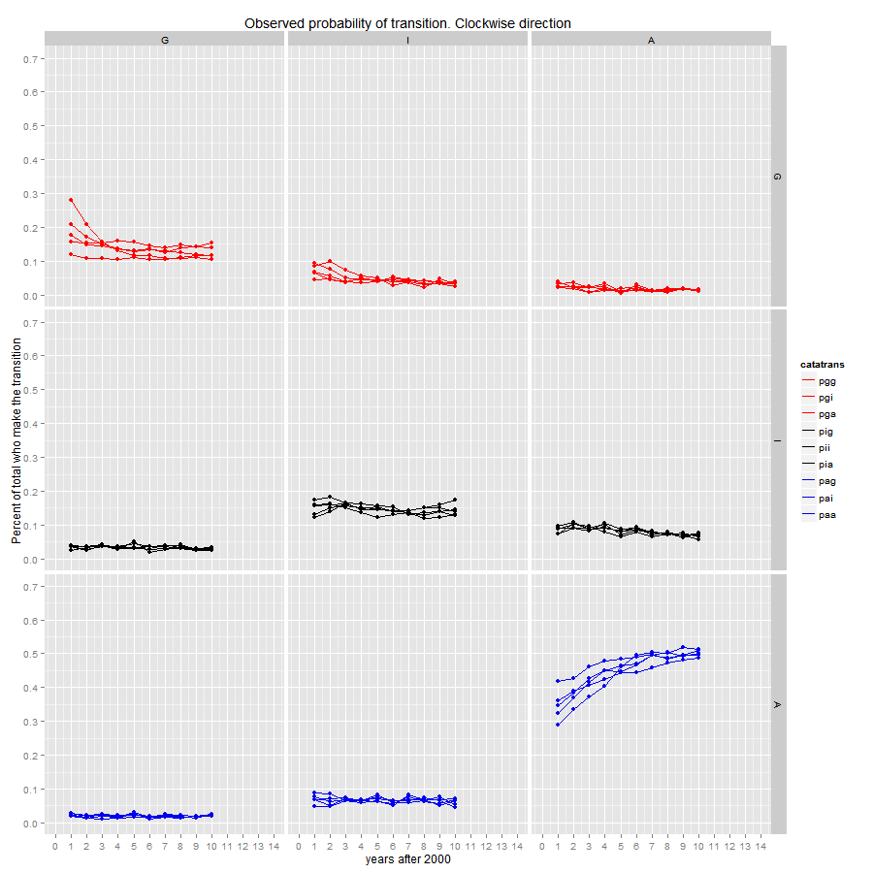

Slide 9
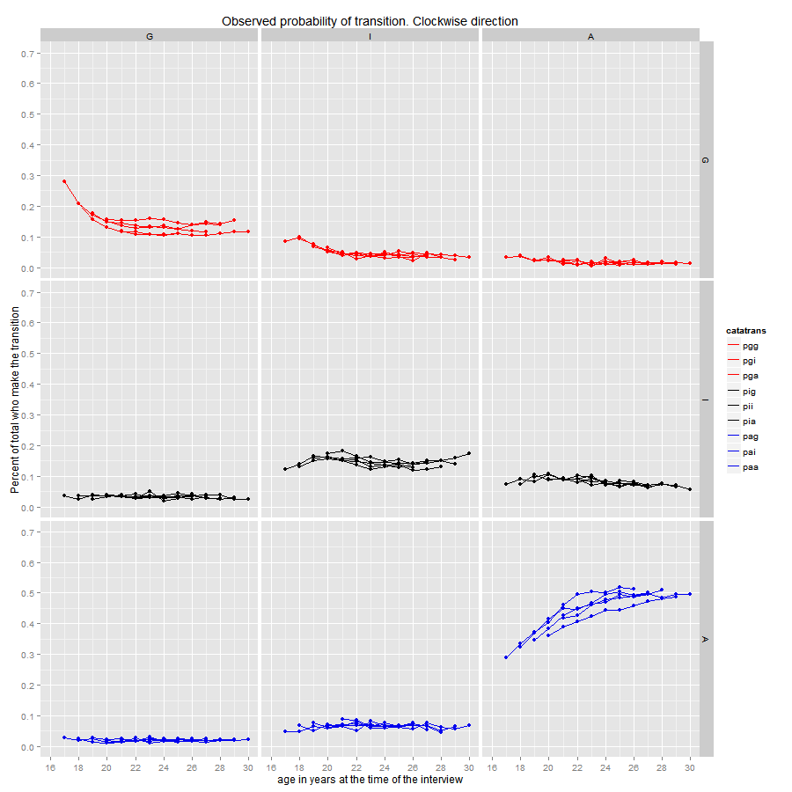

Slide 10
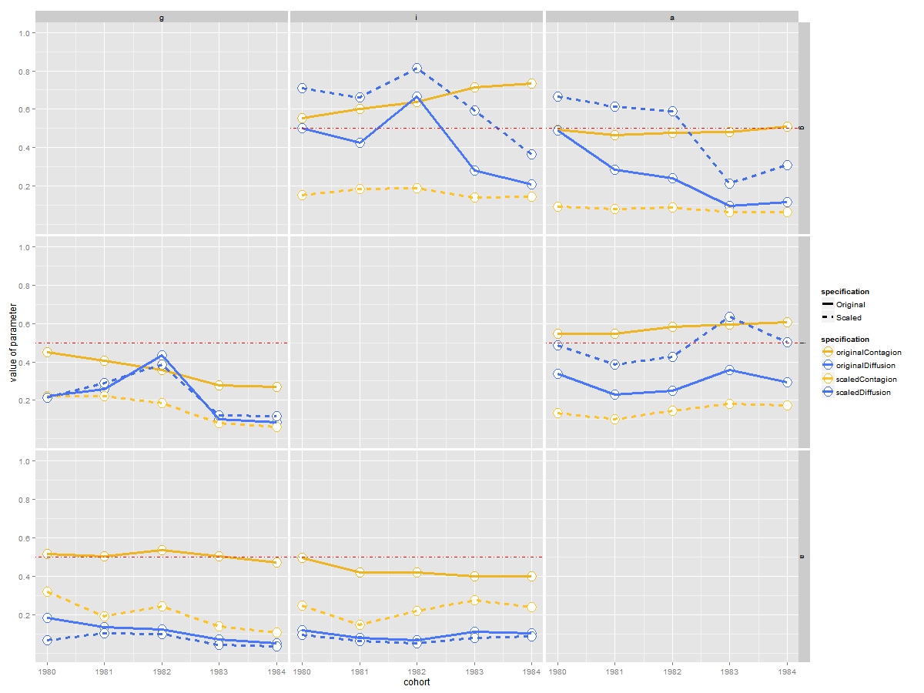
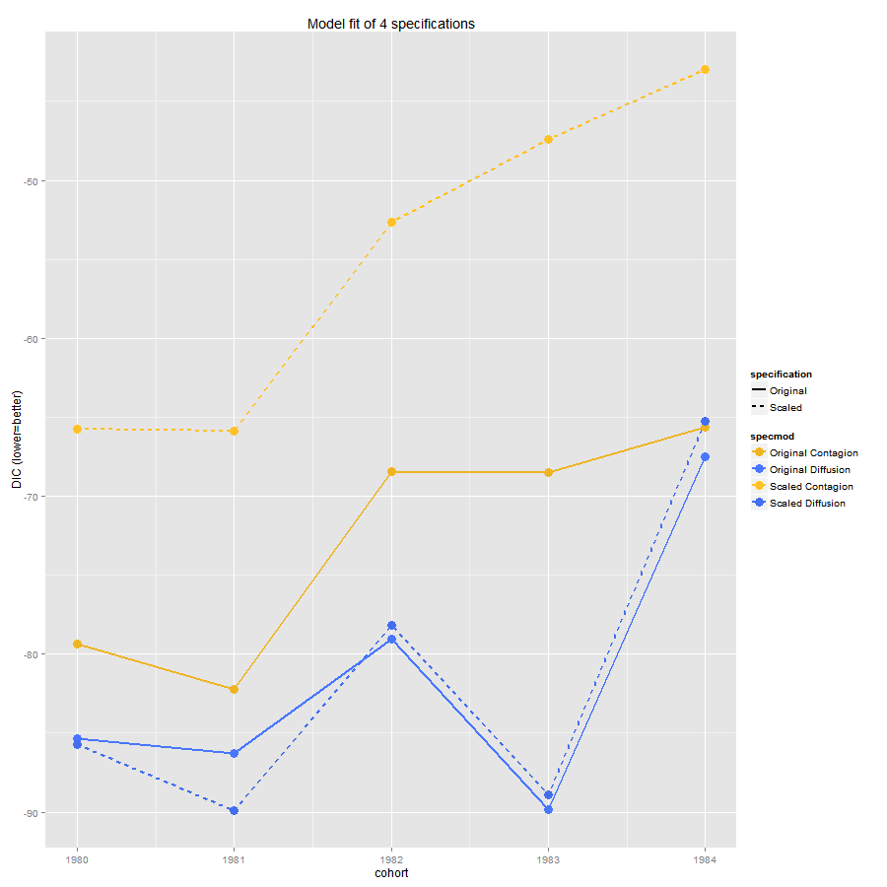

Slide 11
EMOSA specification

